Slide 1

CS 305: Computer Networks Fall 2022
Lecture 2：Introduction
Ming Tang
Department of Computer Science and Engineering
Southern University of Science and Technology (SUSTech)

Slide 2
Chapter 1: roadmap
1.1 what is the Internet?
1.2 network edge
end systems, access networks, links
1.3 network core
packet switching, circuit switching, network structure
1.4 delay, loss, throughput in networks
1.5 protocol layers, service models
1.6 networks under attack: security
1.7 history

Slide 3





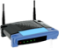

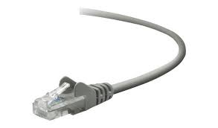
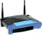

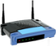
The Internet: a “service” view
The Internet is a computer network that interconnects billions of computing devices throughout the world.
hosts = end systems
Internet applications run on end systems—they do not run in the packet switches in the network core
mobile network
national or global ISP
End systems are connected together by a network of communication links and packet switches.
local or regional ISP
Internet
home network
content
provider
network
Communication links
Packet switches: forward packets (包)
Routers (路由器), switches (交换机)
Networks: collection of devices, routers, links that are managed by an organization
datacenter
network
enterprise
network
Internet: “network of networks”
Interconnected ISPs
Notes:
Deeper into the network
We have packet switches, forward packets, chunks of data., routers and switches
Internet: interconnected networks or international networks.
Interconnected: meaning
To interconnect, communication links: fiber, copper, radio, satellite, connect hosts
Networks: collections of devices,
Each managed by an organizations

Slide 4
A closer look at Internet structure
mobile network
Network edge:
End systems and hosts
Host: Clients and servers
Servers often in data centers
Access networks（接入网）, physical media:
wired, wireless communication links
Network core:
Interconnected routers
Network of networks
national or global ISP
local or regional ISP
home network
content
provider
network
datacenter
network
enterprise
network
Notes:
Network edge
The first hop to get into the Internet, where you need to pay.
All the amazing devices on the edge. Or hosts.
Clients and servers
Clients 客户端 requests and replies a message
Servers are something that provide services, which is generally in datacenter in clouds.

Slide 5



What’s a protocol?
Hi
TCP connection
request
Hi
TCP connection
response
Got the
time?
Get http://www.awl.com/kurose-ross
2:00
<file>
time
Protocols define format, order of messages sent and received among network entities, and actions taken on message transmission and/or receipt
Notes:
Tcp protocols

Slide 6
Internet protocol stack
Application: supporting network applications
IMAP, SMTP, HTTP
Transport: process-process data transfer
TCP, UDP
Network: routing of datagrams from source to destination
IP, routing protocols
Link: data transfer between neighboring network elements
Ethernet, 802.11 (WiFi), PPP
Physical: bits “on the wire”
Application
Transport
Network
Link
Physical
Notes:
Protocol definition?

Slide 7
Chapter 1: roadmap
1.1 what is the Internet?
1.2 network edge
end systems, access networks, links
1.3 network core
packet switching, circuit switching, network structure
1.4 delay, loss, throughput in networks
1.5 protocol layers, service models
1.6 networks under attack: security
1.7 history
Notes:
7
Network edge and network cores

Slide 8














Access networks
The network that physically connects an end system to the first router (edge router) on a path from the end system to any other distant end system.
Cable network
Digital subscriber line (DSL)
Home network
Wireless access network
Enterprise access network
…
Notes:
How to access the internet?
The first hop to
Residential,
School
Mobile, access point
Performance: how to evaluate the performance of different networks
思考：To what degree the users shared the network.

Slide 9
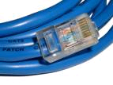


Physical media
guided media:
signals propagate in solid media: copper, fiber, coax
unguided media:
signals propagate freely, e.g., radio (无线电)
Twisted pair (双扭线)
Coaxial cable （同轴电缆）
Fiber optic cable （光纤）
Radio
terrestrial microwave (近地微波)
LAN (e.g., WiFi)
wide-area (e.g., cellular (蜂窝网络))
Satellite (卫星)
Notes:
What is transferred in physical media?
Communication course, the time for a course is limited.
Not cover in this class
High-level
Transmitted in bit
Guided vs unguided

Slide 10
Chapter 1: roadmap
1.1 what is the Internet?
1.2 network edge
end systems, access networks, links
1.3 network core
packet switching, circuit switching, network structure
1.4 delay, loss, throughput in networks
1.5 protocol layers, service models
1.6 networks under attack: security
1.7 history
Notes:
10
Network edge and network cores

Slide 11







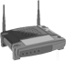

The network core
Network Core: The mesh of packet switches and links that interconnects the Internet’s end systems.
How to exchange messages?
Packet switching: not reserve (预留) resources
Circuit switching (e.g., telephone): reserve
Packet switching: hosts break long messages into packets
Each packet travels through communication links and packet switches
Forward packets from one router to the next, across links on path from source to destination
Each packet transmitted at full link capacity

Slide 12



Packet-switching: store-and-forward
L bits
per packet
source
3
2
1
R bps
R bps
destination
router
Takes L/R seconds to transmit (push out) L-bit packet into link at R bps
Store and forward: entire packet must arrive at router before it can be transmitted on next link
Example:
L = 7.5 Mbits；R = 1.5 Mbps
One-hop transmission delay = L/R = 5 sec
End-to-end delay = 2L/R (assuming zero propagation delay)
How about one packet of length L sending over a path of N links, each of rate R?
more on delay shortly …

Slide 13
Packet Switching: queueing delay, loss
R = 100 Mb/s
C
A
D
R = 15 Mb/s
B
E
Queue(队列) of packets
waiting for output link
Output buffer stores packets that the router is about to send into that link.
If arrival rate (in bits) to link exceeds transmission rate of link for a period of time:
packets will queue, wait to be transmitted on link → queuing delay
packets can be dropped (lost) if memory (buffer) fills up → packet loss
Queuing and Loss Interactive Animation (unicam.it)

Slide 14
Two key network-core functions
Routing Algorithm
Routing:
global action: determine source-destination paths taken by packets
routing algorithms
Forwarding:
local action: move arriving packets from router’s input link to appropriate router output link
Forwarding Table
Header value
output link
0100
0101
0111
1001
3
2
2
1
1
3
2
0111
destination address in arriving
packet’s header

Slide 15
Alternative core: circuit switching
Packet switching: on demand; may wait
Circuit switching: end-to-end resources reserved for “call” between source and destination; guaranteed rate
(buffer, link, transmission rate)
commonly used in traditional telephone networks
In diagram, each link has four circuits.
call gets 2nd circuit in top link and 1st circuit in right link.
dedicated resources: no sharing
a fraction of each link’s capacity
circuit-like; guaranteed constant rate
circuit segment idle if not used by call (no sharing)

Slide 16
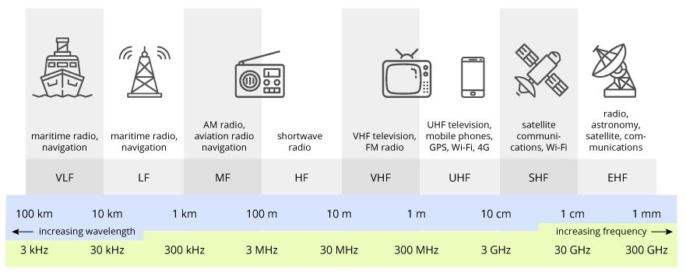
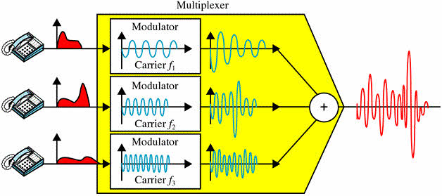
Circuit switching: FDM versus TDM
Frequency Division Multiplexing (FDM)
Optical, electromagnetic frequencies divided into (narrow) frequency bands → bandwidth
At max rate of that narrow band
4 users
frequency
time
Time Division Multiplexing (TDM)
Time divided into slots
At maximum rate of (wider) frequency band, but only during its time slot(s)
frequency
time
Notes:
Two simple multiple access control techniques.
Each mobile’s share of the bandwidth is divided into portions for the uplink and the downlink. Also, possibly, out of band signaling.
As we will see, used in AMPS, GSM, IS-54/136

Slide 17
Circuit Switching: Delay
Host A
A file of 640,000 bits
All links in the network use TDM with 24 slots and have a bit rate of 1.536 Mbps.
It takes 500 msec to establish an end-to-end link.
How long does it take to send the file?
Each circuit has a transmission rate of 1.536 Mbps/24 = 64 kbps
It takes 640,000 bits / 64 kbps = 10 sec
Total: 10 sec + 500 msec = 10.5 sec
Host B

Slide 18
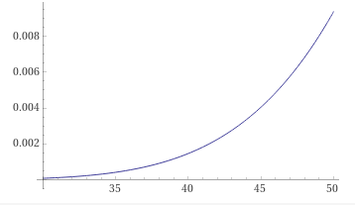
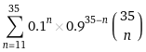
Packet switching versus circuit switching
Packet switching allows more users to use network!
Circuit switching pre-allocates use of the transmission link regardless of demand, with allocated but unneeded link time going unused.
Packet switching on the other hand allocates link use on demand.
Example:
1 Mb/s link
Each user:
active 10% of time
100 kbps when “active”
Circuit switching:
10 users
Packet switching:
With 35 users, that probability that more than 10 users are active at same time is less than 0.0004.
N
users
…..
1 Mbps link
Q: how did we get value 0.0004?
Q: what happens if > 35 users ?

Slide 19
Packet switching versus circuit switching
Packet switching：
great for bursty data
resource sharing
simpler, no call setup
excessive congestion possible: packet delay and loss
protocols needed for reliable data transfer, congestion control
Q: How to provide circuit-like behavior?
bandwidth guarantees needed for audio/video apps
still an unsolved problem (chapter 7)
Q: human analogies of reserved resources (circuit switching) versus on-demand allocation (packet switching)?

Slide 20
Internet structure: network of networks
End systems connect to Internet via access ISPs (Internet Service Providers)
Residential, company and university ISPs
E.g., China Mobile, university.
Access ISPs in turn must be interconnected.
So that any two hosts can send packets to each other
Resulting network of networks is very complex
Evolution was driven by economics and national policies
national or global ISP
local or regional ISP
Internet
home network
content
provider
network
datacenter
network
enterprise
network
Let’s take a stepwise approach to describe current Internet structure.

Slide 21
Internet structure: network of networks
Question: given millions of access ISPs, how to connect them together?
…
…
access
net
access
net
access
net
access
net
access
net
access
net
access
net
…
…
access
net
access
net
access
net
access
net
access
net
access
net
…
access
net
access
net
…
access
net

Slide 22
Internet structure: network of networks
Option 1: connect each access ISP to every other access ISP?
…
…
access
net
access
net
access
net
access
net
access
net
access
net
…
…
access
net
…
connecting each access ISP to each other directly doesn’t scale: O(N²) connections.
…
access
net
…
access
net
…
access
net
access
net
access
net
access
net
…
access
net
access
net
…
access
net
…

Slide 23
Internet structure: network of networks
Option 2: connect each access ISP to a global transit ISP? Customer and provider ISPs have economic agreement.
…
…
access
net
access
net
access
net
access
net
access
net
access
net
access
net
…
…
global ISP
access
net
access
net
access
net
access
net
access
net
access
net
…
access
net
access
net
…
access
net

Slide 24
Internet structure: network of networks
But if one global ISP is viable business, there will be competitors ….
…
…
access
net
access
net
access
net
access
net
access
net
access
net
access
net
ISP A
…
…
access
net
ISP B
access
net
ISP C
access
net
access
net
access
net
access
net
…
access
net
access
net
…
access
net

Slide 25
Internet structure: network of networks
But if one global ISP is viable business, there will be competitors …. which must be interconnected
Internet exchange point
…
…
access
net
access
net
access
net
access
net
access
net
IXP
access
net
access
net
ISP A
…
…
IXP
access
net
access
net
ISP B
ISP C
access
net
access
net
peering link
access
net
access
net
…
access
net
access
net
…
access
net

Slide 26
Internet structure: network of networks
… and regional networks may arise to connect access nets to ISPS
…
…
access
net
access
net
access
net
access
net
access
net
IXP
access
net
access
net
ISP A
…
…
IXP
access
net
access
net
ISP B
ISP C
access
net
access
net
access
net
regional net
access
net
…
access
net
access
net
…
access
net

Slide 27
Internet structure: network of networks
… and content provider networks (e.g., Google, Microsoft) may run their own network, to bring services, content close to end users
…
…
access
net
access
net
access
net
access
net
access
net
IXP
access
net
access
net
ISP A
…
…
Content provider network
IXP
access
net
access
net
ISP B
ISP B
access
net
access
net
access
net
regional net
access
net
…
access
net
access
net
…
access
net

Slide 28
Internet structure: network of networks
Tier 1 ISP
Tier 1 ISP
Google
IXP
IXP
IXP
Regional ISP
Regional ISP
access
ISP
access
ISP
access
ISP
access
ISP
access
ISP
access
ISP
access
ISP
access
ISP
“Tier-1” commercial ISPs (e.g., Level 3, Sprint, AT&T, NTT), national & international coverage
Multi-homing：to connect to two or more provider ISPs
Peer: a pair of nearby ISPs at the same level
Content provider network (e.g, Google): private network that connects it data centers to Internet, often bypassing tier-1, regional ISPs

Slide 29
Chapter 1: roadmap
1.1 what is the Internet?
1.2 network edge
end systems, access networks, links
1.3 network core
packet switching, circuit switching, network structure
1.4 delay, loss, throughput in networks
1.5 protocol layers, service models
1.6 networks under attack: security
1.7 history
Notes:
29
Network edge and network cores

Slide 30
Performance Metric
We would like Internet services to be able to move as much data as we want between any two end systems, instantaneously, without any loss of data.
In Packet-Switched Networks:
Throughput: the amount of data per second that can be transferred between end systems
Delay
Packet loss

Slide 31
How do loss and delay occur?
Packets queue in router buffers
packet arrival rate to link (temporarily) exceeds output link capacity
packets queue, wait for turn
packet being transmitted (delay)
A
B
packets queueing (delay)
free (available) buffers: arriving packets
dropped (loss) if no free buffers

Slide 32
Four sources of packet delay
transmission
A
propagation
B
nodal
processing
queueing
Nodal (节点) delay
d_{nodal} = d_{proc} + d_{queue} + d_{trans} + d_{prop}
d_{proc}: nodal processing
check bit errors
determine output link
typically < msec
d_{queue}: queueing delay
time waiting at output link for transmission
depends on congestion level of router

Slide 33
Four sources of packet delay
transmission
A
propagation
B
nodal
processing
queueing
Nodal (节点) delay
d_{nodal} = d_{proc} + d_{queue} + d_{trans} + d_{prop}
d_{trans}: transmission delay (传输时延):
L: packet length (bits)
R: transmission rate (bps)
d_{trans} = L/R
d_{prop}: propagation delay (传播时延):
d: length of physical link
s: propagation speed in medium (~2x10⁸ m/sec)
d_{prop} = d/s
d_{trans} and d_{prop}
very different
Notes:
33

Slide 34
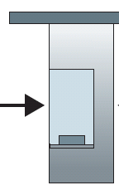
Caravan analogy
100 km
100 km
ten-car
Caravan (旅行车队)
Tollbooth（收费站）
Tollbooth（收费站）
Cars “propagate” at 100 km/hr
Tollbooth takes 12 sec to service one car (bit transmission time)
car~bit; caravan ~ packet
Transmission delay：time to “push” entire caravan through tollbooth onto highway = 12*10 = 120 sec
Propagation delay：time for last car to propagate from 1st to 2nd toll both: 100km/(100km/hr)= 1 hr
A: 62 minutes
Q: How long does it take the first car to arrive at the 2nd tollbooth?

Slide 35
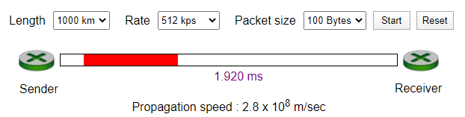
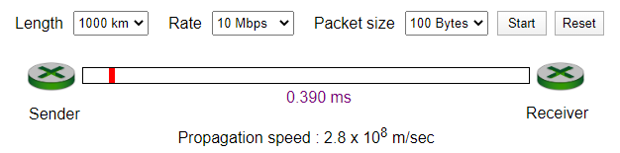
Caravan analogy (more)
100 km
100 km
ten-car
Caravan (旅行车队)
Tollbooth（收费站）
Tollbooth（收费站）
Suppose cars now “propagate” at 1000 km/hr
and suppose tollbooth now takes one min to service a car
Q: Will cars arrive to 2nd booth before all cars serviced at first booth?
A: Yes! after 7 min, 1st car arrives at second booth; three cars still at 1st booth.
Transmission versus Propagation Delay Interactive Animation (unicam.it)

Slide 36
Queueing delay (revisited)
Nodal (节点) delay
d_{nodal} = d_{proc} + d_{queue} + d_{trans} + d_{prop}
Unlike the other three delays (namely, d_{proc，}d_{trans，}d_{prop}), the queuing delay can vary from packet to packet.
When characterizing queuing delay, statistical measures:
average queuing delay
variance of queuing delay
the probability that the queuing delay exceeds some specified value

Slide 37
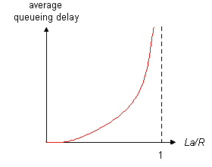

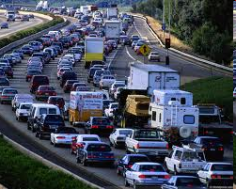
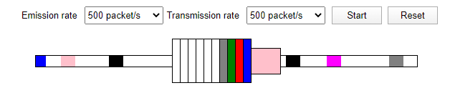
Queueing delay (revisited)
L bits
per packet
source
3
2
1
R bps
R bps
destination
router
R: transmission rate (bps)
L: packet length (bits)
a: average packet arrival rate (packets per sec)
La/R → 0
average queueing delay
La/R →0: avg. queueing delay small
La/R → 1: avg. queueing delay large
La/R > 1: more “work” arriving
than can be serviced, average delay infinite!
La/R → 1
traffic intensity
= La/R
Queuing and Loss Interactive Animation (unicam.it)

Slide 38
Packet loss
Queue (aka buffer) preceding link in buffer has finite capacity
Packet arriving to full queue will be dropped (aka lost)
Lost packet may be retransmitted by previous node, by source end system, or not at all
buffer
(waiting area)
A
packet being transmitted
B
packet arriving to
full buffer is lost

Slide 39
End-to-End Delay
C
A
D
B
E
Suppose d_{queue} is negligible; N-1 routers between two hosts
End-to-End delay
d_{end-end} = N (d_{proc} + d_{trans} + d_{prop})

Slide 40
“Real” Internet delays and routes
What do “real” Internet delay & loss look like?
Traceroute program: provides delay measurement from source to router along end-end Internet path towards destination. For all i:
sends three packets that will reach router i on path towards destination
router i will return packets to sender
sender times interval between transmission and reply.
3 probes
3 probes
3 probes
N-1 routers, send 3N packets

Slide 41
“Real” Internet delays, routes
traceroute: gaia.cs.umass.edu to www.eurecom.fr
3 delay measurements from
gaia.cs.umass.edu to cs-gw.cs.umass.edu
1 cs-gw (128.119.240.254) 1 ms 1 ms 2 ms
2 border1-rt-fa5-1-0.gw.umass.edu (128.119.3.145) 1 ms 1 ms 2 ms
3 cht-vbns.gw.umass.edu (128.119.3.130) 6 ms 5 ms 5 ms
4 jn1-at1-0-0-19.wor.vbns.net (204.147.132.129) 16 ms 11 ms 13 ms
5 jn1-so7-0-0-0.wae.vbns.net (204.147.136.136) 21 ms 18 ms 18 ms
6 abilene-vbns.abilene.ucaid.edu (198.32.11.9) 22 ms 18 ms 22 ms
7 nycm-wash.abilene.ucaid.edu (198.32.8.46) 22 ms 22 ms 22 ms
8 62.40.103.253 (62.40.103.253) 104 ms 109 ms 106 ms
9 de2-1.de1.de.geant.net (62.40.96.129) 109 ms 102 ms 104 ms
10 de.fr1.fr.geant.net (62.40.96.50) 113 ms 121 ms 114 ms
11 renater-gw.fr1.fr.geant.net (62.40.103.54) 112 ms 114 ms 112 ms
12 nio-n2.cssi.renater.fr (193.51.206.13) 111 ms 114 ms 116 ms
13 nice.cssi.renater.fr (195.220.98.102) 123 ms 125 ms 124 ms
14 r3t2-nice.cssi.renater.fr (195.220.98.110) 126 ms 126 ms 124 ms
15 eurecom-valbonne.r3t2.ft.net (193.48.50.54) 135 ms 128 ms 133 ms
16 194.214.211.25 (194.214.211.25) 126 ms 128 ms 126 ms
17 * * *
18 * * *
19 fantasia.eurecom.fr (193.55.113.142) 132 ms 128 ms 136 ms
trans-oceanic link
looks like delays decrease! Why?
* means no response (probe lost, router not replying)
* Do some traceroutes from exotic countries at www.traceroute.org

Slide 42
Throughput
Throughput: rate (bits/time unit) at which bits transferred between sender/receiver
instantaneous: rate at given point in time
average: rate over longer period of time
A file of F bits; it takes T seconds for the receiver to receive the file → Average throughput of F/T bits/sec.
The rate (bits/time unit) at which the receiver is receiving the file.
server sends bits
(fluid) into pipe
link capacity
R_{s} bits/sec
server, with
file of F bits
to send to client
pipe that can carry
fluid at rate
R_{s} bits/sec)
link capacity
R_{c} bits/sec
pipe that can carry
fluid at rate
R_{c} bits/sec)
What is the server-to-client throughput?

Slide 43
Throughput (more)
R_{s} < R_{c} What is average end-end throughput?
R_{s} bits/sec
R_{c} bits/sec
R_{s} > R_{c} What is average end-end throughput?
R_{s} bits/sec
R_{c} bits/sec
min{R_{s}, R_{c}}
bottleneck link
link on end-end path that constrains end-end throughput

Slide 44
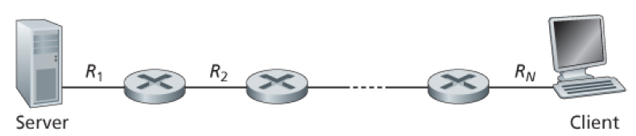
Throughput (more)
What is average end-end throughput?
min{R₁, R₂, …, R_{N}}

Slide 45
Throughput: Internet scenario
10 connections (fairly) share backbone bottleneck link R bits/sec
Per-connection end-end throughput: min{R_{c},R_{s},R/10}
In practice: R_{c} or R_{s} is often bottleneck
R_{s}
R_{s}
R_{s}
R
R_{c}
R_{c}
R_{c}

Slide 46
Chapter 1: roadmap
1.1 what is the Internet?
1.2 network edge
end systems, access networks, links
1.3 network core
packet switching, circuit switching, network structure
1.4 delay, loss, throughput in networks
1.5 protocol layers, service models
1.6 networks under attack: security
1.7 history
Notes:
46
Network edge and network cores

Slide 47
Protocol “layers”
Networks are complex,
with many “pieces”:
hosts
routers
links of various media
applications
protocols
hardware, software
Question:
is there any hope of organizing structure of network?
…. or at least our discussion of networks?

Slide 48

Organization of air travel
ticket (purchase)
baggage (check)
gates (load)
runway takeoff
airplane routing
ticket (complain)
baggage (claim)
gates (unload)
runway landing
airplane routing
airplane routing

Slide 49
Layering of airline functionality
ticket (purchase)
baggage (check)
gates (load)
runway (takeoff)
airplane routing
ticket (complain)
baggage (claim
gates (unload)
runway (land)
airplane routing
ticket
baggage
gate
takeoff/landing
airplane routing
airplane routing
airplane routing
departure
airport
intermediate air-traffic
control centers
arrival
airport
Layers: Each layer provide services to the layer above
via its own internal-layer actions
relying on services provided by layer below

Slide 50
Layering of functionality
application
transport
network
link
physical
application
transport
network
link
physical
Layers: Each layer provide services to the layer above
via its own internal-layer actions
relying on services provided by layer below
For example, reliable delivery of messages at layer n:
Adding layer n functionality to detect and retransmit lost messages
Using an unreliable message delivery service at layer n-1

Slide 51
Why layering?
Dealing with complex systems:
Explicit structure allows identification, relationship of complex system’s pieces
layered reference model for discussion
modularization eases maintenance, updating of system
change of implementation of layer’s service transparent to rest of system
e.g., change in gate procedure doesn’t affect rest of system
drawback?
One layer may duplicate lower layer functionality
Functionality at one layer may need information that is present only in another layer

Slide 52
Internet protocol stack
Application: supporting network applications
FTP, SMTP, HTTP
Transport: process-process data transfer
TCP, UDP
Network: routing of datagrams from source to destination
IP, routing protocols
Link: data transfer between neighboring network elements
Ethernet, 802.111 (WiFi), PPP
Physical: bits “on the wire”
application
transport
network
link
physical

Slide 53

Internet protocol stack

Slide 54
ISO/OSI reference model
Presentation: allow applications to interpret meaning of data, e.g., encryption, compression, machine-specific conventions
Session: synchronization, checkpointing, recovery of data exchange
Internet stack “missing” these layers!
these services, if needed, must be implemented in application
needed?
application
presentation
session
transport
network
link
physical

Slide 55
Encapsulation (封装)
source
message
M
application
transport
network
link
physical
segment
H_{t}
M
H_{t}
datagram
H_{n}
H_{n}
H_{t}
M
frame
H_{l}
H_{n}
H_{t}
M
link
physical
switch
destination
H_{n}
H_{t}
M
network
link
physical
M
application
transport
network
link
physical
H_{l}
H_{n}
H_{t}
M
H_{n}
H_{t}
M
H_{t}
M
H_{n}
H_{t}
M
H_{l}
H_{n}
H_{t}
M
router

Slide 56
Encapsulation (封装)
source
message
M
application
transport
network
link
physical
segment
H_{t}
M
H_{t}
datagram
H_{n}
H_{n}
H_{t}
M
frame
H_{l}
H_{n}
H_{t}
M
link
physical
switch
destination
H_{n}
H_{t}
M
network
link
physical
M
application
transport
network
link
physical
H_{l}
H_{n}
H_{t}
M
H_{n}
H_{t}
M
H_{t}
M
H_{n}
H_{t}
M
H_{l}
H_{n}
H_{t}
M
router

Slide 57
Chapter 1: roadmap
1.1 what is the Internet?
1.2 network edge
end systems, access networks, links
1.3 network core
packet switching, circuit switching, network structure
1.4 delay, loss, throughput in networks
1.5 protocol layers, service models
1.6 networks under attack: security
1.7 history
Notes:
57
Network edge and network cores

Slide 58
Network security
We attach devices to the Internet because we want to receive/send data from/to the Internet
Field of network security:
how bad guys can attack computer networks
how we can defend networks against attacks
how to design architectures that are immune to attacks
Internet not originally designed with (much) security in mind
original vision: “a group of mutually trusting users attached to a transparent network” ☺
Internet protocol designers playing “catch-up”
security considerations in all layers!

Slide 59
Bad guys: put malware (恶意软件) into hosts via Internet
malware can get in host from:
virus: self-replicating infection by receiving/executing object (e.g., e-mail attachment) – with user interaction
worm: self-replicating infection by passively receiving object that gets itself executed – without user interaction
spyware malware can record keystrokes, web sites visited, upload info to collection site
infected host can be enrolled in botnet (僵尸网络), used for spam. DDoS attacks

Slide 60
Bad guys: attack server, network infrastructure
Denial of Service (DoS): attackers make resources (server, bandwidth) unavailable to legitimate traffic by overwhelming resource with bogus traffic
1. select target
2. break into hosts around the network (see botnet)
3. send packets to target from compromised hosts
target

Slide 61
Bad guys can sniff packets
Packet “sniffing”:
Broadcast media (shared ethernet, wireless)
Reads/records all packets (e.g., including passwords!) passing by
They are difficult to detect
A
C
src:B dest:A payload
B
wireshark software used for end-of-chapter labs is a (free) packet-sniffer

Slide 62
Bad guys can use fake addresses
IP spoofing: send packet with false source address
A
C
src:B dest:A payload
B

Slide 63

Network under Attack

Slide 64
Lines of defense:
authentication: proving you are who you say you are
cellular networks provides hardware identity via SIM card; no such hardware assist in traditional Internet
confidentiality: via encryption
integrity checks: digital signatures prevent/detect tampering
access restrictions: password-protected VPNs
firewalls: specialized “middleboxes” in access and core networks:
off-by-default: filter incoming packets to restrict senders, receivers, applications
detecting/reacting to DOS attacks
… lots more on security (throughout, Chapter 8)
Notes:
To defeind against these attacks,
There are multiple ways we often do.
For example, authentication, encryption, firewalls
身份验证，加密和防火墙等等。

Slide 65
Chapter 1: roadmap
1.1 what is the Internet?
1.2 network edge
end systems, access networks, links
1.3 network core
packet switching, circuit switching, network structure
1.4 delay, loss, throughput in networks
1.5 protocol layers, service models
1.6 networks under attack: security
1.7 history
Notes:
65
Network edge and network cores

Slide 66
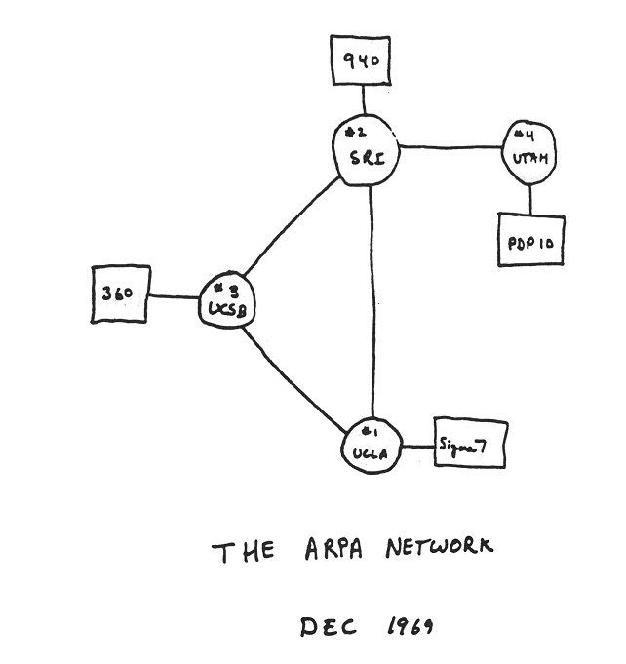
Internet history
1961-1972: Early packet-switching principles
1961: Kleinrock - queueing theory shows effectiveness of packet-switching
1964: Baran - packet-switching in military nets
1967: ARPAnet conceived by Advanced Research Projects Agency
1969: first ARPAnet node operational
1972:
ARPAnet public demo
NCP (Network Control Protocol) first host-host protocol
first e-mail program
ARPAnet has 15 nodes

Slide 67
Internet history
1972-1980: Internetworking, new and proprietary nets
1970: ALOHAnet satellite network in Hawaii
1974: Cerf and Kahn - architecture for interconnecting networks
1976: Ethernet at Xerox PARC
late70’s: proprietary architectures: DECnet, SNA, XNA
late 70’s: switching fixed length packets (ATM precursor)
1979: ARPAnet has 200 nodes
Cerf and Kahn’s internetworking principles:
minimalism, autonomy - no internal changes required to interconnect networks
best effort service model
stateless routers
decentralized control
define today’s Internet architecture

Slide 68
Internet history
1980-1990: new protocols, a proliferation of networks
1983: deployment of TCP/IP
1982: smtp e-mail protocol defined
1983: DNS defined for name-to-IP-address translation
1985: ftp protocol defined
1988: TCP congestion control
new national networks: Csnet, BITnet, NSFnet, Minitel
100,000 hosts connected to confederation of networks

Slide 69
Internet history
1990, 2000’s: commercialization, the Web, new apps
early 1990’s: ARPAnet decommissioned
1991: NSF lifts restrictions on commercial use of NSFnet (decommissioned, 1995)
early 1990s: Web
hypertext [Bush 1945, Nelson 1960’s]
HTML, HTTP: Berners-Lee
1994: Mosaic, later Netscape
late 1990’s: commercialization of the Web
late 1990’s – 2000’s:
more killer apps: instant messaging, P2P file sharing
network security to forefront
est. 50 million host, 100 million+ users
backbone links running at Gbps

Slide 70
Internet history
2005-present
~750 million hosts
Smartphones and tablets
Aggressive deployment of broadband access
Increasing ubiquity of high-speed wireless access
Emergence of online social networks:
Facebook: soon one billion users
Service providers (Google, Microsoft) create their own networks
Bypass Internet, providing “instantaneous” access to search, emai, etc.
E-commerce, universities, enterprises running their services in “cloud” (eg, Amazon EC2)

Slide 71

Internet history

Slide 72
Introduction: summary
Covered a “ton” of material!
Internet overview
what’s a protocol?
network edge, core, access network
packet-switching versus circuit-switching
Internet structure
performance: loss, delay, throughput
layering, service models
security
history
you now have:
context, overview, “feel” of networking
more depth, detail to follow!
application
transport
network
link
physical

Slide 73
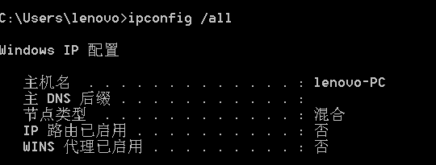
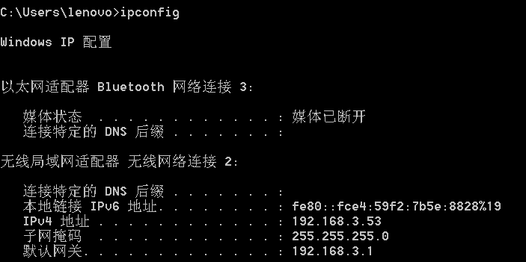
Three big questions
Who am I?
Host name
Why am I here?
IP address:
IPv4: 32-bit
IPv6: 128-bit
ICANN
Subnet mask
Default gateway

Slide 74
IP address and Subnets
223.1.1.0/24
IP address:
subnet part - high order bits
host part - low order bits
what’s a subnet ?
device interfaces with same subnet part of IP address
can physically reach each other without intervening router
223.1.2.0/24
223.1.1.1
223.1.1.2
223.1.2.1
223.1.1.4
223.1.2.9
223.1.2.2
223.1.1.3
223.1.3.27
subnet
223.1.3.1
223.1.3.2
223.1.3.0/24
subnet mask: /24
255.255.255.0

Slide 75
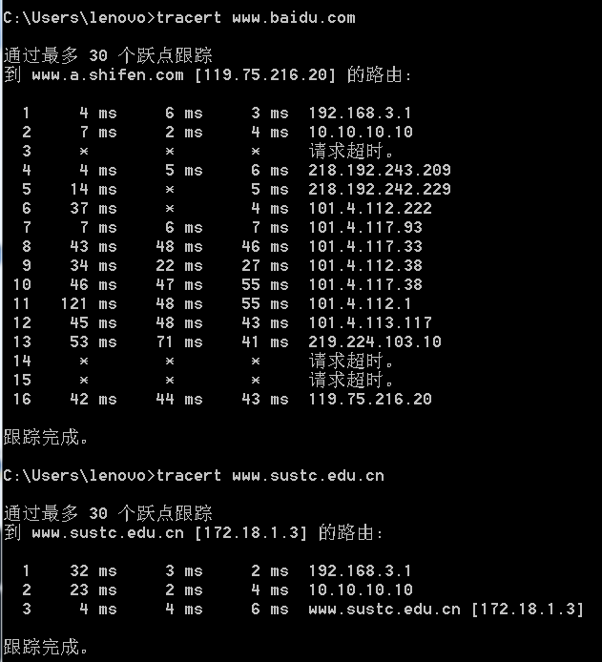
Three big questions
Where am I going?
Go through multiple hops
Number of hops varies
Delay for each hop varies
Internal address vs.
external address
www.sustc.edu.cn
172.18.1.3 (internal)
116.7.234.3 (external)
3 probes
3 probes
3 probes

